Slide 1
Health Equity and Disability: Impacts of Unconscious Bias and Diagnostic Overshadowing
Holly Darnell, MS OTR/L, ADAC
ADA Coordinator, UCHealth Medical Group
Notes:
UCHealth – 12 hospitals, 150+ outpatient clinics in Colorado, Wyoming and Nebraska

Slide 2
Presentation outline
Introduction to Unconscious Bias
Types of Bias
Bias and Disability
Diagnostic Overshadowing
Case Examples
Strategies to Overcome Diagnostic Overshadowing

Slide 3
“I sometimes find myself tempted to leave them (mental illness medications) off the list of medications I provide to practitioners. I worry about how disclosing my medication regimen may influence the way a doctor views me. I almost never reveal I have Bipolar Disorder because of the stigma associated with that diagnosis”

Slide 4
Introduction to Unconscious Bias
Notes:
We’ll start with a few examples of the way our brain can automatically fill in information without us realizing it. There will be two visual examples and one audio example and both will be explained as thoroughly as possible for participants who may not be able to see or hear the examples.

Slide 5
Unconscious Bias Example 1
To the right are two images of faces. For most people, one face will appear to feminine and one will appear to be masculine. Which face is which for you?

Slide 6
Unconscious Bias Example 1 Explanation
Both faces are the same face, the only difference between the two images is the contrast of the face and the skin tone.
Our brains have stored information about contrast as it relates to what we perceive as feminine and masculine. In the absence of other common visual cues, this information can fill in the gaps to interpret the information we do have based on what we commonly know.

Slide 7
Unconscious Bias Example 2
Can you find 16 circles in the image to the right?
Do you first see a series of rectangles that appear to be sunken, like door panels?

Slide 8
Unconscious Bias Example 2 – The Coffer Illusion
This illusion relies on our brain’s nature to identify objects based on things we already know or commonly see.
There is no “right” or “one” way to see this image because it is inherently ambiguous – both the view of sets of lines and of circles can co-exist.
For most people – the grouping of rectangles is seen first perhaps because this shape is more common in our daily environment.
Notes:
While we may initially see one representation in the image (lines), with focus and effort we can change our perception to see the circles. Once the circles can be seen, we can often go back and forth between both views of the image, or sometimes even see both possibilities at the same time. The conscious parts of our brain can force us to interpret the image in a new way once we know what to look for.

Slide 9
Unconscious Bias Example 3 - Auditory
An Audio Illusion

Slide 10
What is Bias?
Biases are tendencies, inclinations or prejudices towards or against something or someone. Biases can be:
Conscious: refers to the tendency, attitude and beliefs we have about a person or group on a conscious level
Unconscious: refers to the attitudes or stereotypes that affect our understanding, actions and decisions in an unconscious manner
The previous examples highlighted ways that our unconscious mind can influence how we interpret the world.

Slide 11
Bias Continued
Stereotypes are fixed, overgeneralized beliefs about a particular group or class of people.
Prejudices are unfavorable beliefs formed without basis. They are a prejudgment or unjustifiable attitude of one individual or group towards another.
Bias is neither inherently good nor bad.
Notes:
Some biases are hardwired into us from evolution, others are learned through socialization or a combination of our genetics and experiences. Biases allow us to make choices in an efficient way and can be adaptive when they do not impact the quality of our decision making and when there is evidence to support them. Biases can also be maladaptive when they cause us to rely on faulty information or they do not generalize to a situation to which they are applied.

Slide 12
Unconscious Bias
Unconscious bias is an automatic, mental shortcut used to process information and make decisions quickly.
Attitudes or stereotypes can affect our understanding, actions and decisions in an unconscious manner.
Unconscious bias is normal – everyone has some biases!
Unconscious bias can be good and bad.

Slide 13
Types of Unconscious Biases
Attribution Bias: refers to the tendency to explain a person’s behavior by referring to their character rather than any situational factor
Affinity (similarity) Bias: refers to our tendency to gravitate towards people similar to ourselves
Confirmation Bias: attributing our own bad acts to forces outside of our control, and other people’s bad acts as indicative of who they are as a person
Halo Bias: when we perceive one great thing about a person and we let the halo glow of that one thing affect our opinions of everything else about that person
Horns Bias: opposite of the Halo- occurs when generalizing one negative aspect of a person to all areas
Prototype Bias: assuming that someone is or is not the perfect fit for a role or task based on stereotyping

Slide 14
Impacts of Unconscious Bias - Microaggressions
Microaggressions are statements, actions, or incidents regarded as an instance of indirect, subtle or unintentional discrimination against members of a historically discriminated community, such as people with disabilities.
Examples of microaggressions towards people with disabilities:
“I can’t believe you are married”
“We all have some disability”
“You are too young to use hearing aids”
“You don’t look like you have a disability”
Someone helping a person with a disability that does not need help, or treating people with disabilities like a child and doing things for them without asking
Notes:
Denial of personal identity outside of being a person with a disability
Denial of disability experience
Helplessness – when people try to frantically help PWDs
Infantillization – when a PWD is treated like a child

Slide 15
Impacts of Unconscious Bias - Discrimination
Discrimination is the unfair or prejudicial treatment of people and groups based on characteristics such as race, age, gender, sexual orientation, disability, etc.
Ableism is discrimination based on how a person may exhibit or seem to show signs of disability.
Examples of Ableism/Disability Discrimination:
Only having stairs to the main entry of a building
Refusing to treat patients with a disability
Not providing effective communication to patients with disabilities
Making assumptions about the quality of life of a person with a disability

Slide 16
Biases and Disability in Healthcare
One recent study surveyed physicians about their perspectives of people with disabilities and found the following:
Only around half of physicians surveyed “strongly” agreed that they would welcome people with disabilities into their practices.
More than 4/5 of surveyed physicians indicated that people with significant disability have “worse” quality of life than people without disability.
Only 2/5 of surveyed physicians indicated that they felt “very confident” in their ability to provide the same quality of care to people with disabilities that they provide to people without disabilities.

Slide 17
Diagnostic Overshadowing

Slide 18
What is Diagnostic Overshadowing?
Began as a way of naming the issue of missed diagnoses of mental illnesses in individuals with intellectual disabilities as early as the 1980s. Has grown and expanded over time to include broader definitions such as:
Misdiagnosis of one physical malady as being caused by a different, already diagnosed physical illness
When symptoms arising from physical or mental health problems are misattributed to an individual’s learning disability
Process by which a person with mental illness receives inadequate treatment because their physical symptoms are misattributed to the mental illness
Attribution of symptoms to an existing diagnosis rather than a potential co-morbid condition

Slide 19
Who Diagnostic Overshadowing Impacts
Diagnostic overshadowing can impact the interactions of clinicians with patients of all ages who have physical disabilities or preexisting conditions (such as autism, mobility disabilities, mental health conditions, or neurological disabilities) as well as patients with conditions or characteristics such as LBGTQA+ identities, history of substance abuse, low health literacy, and obesity.

Slide 20
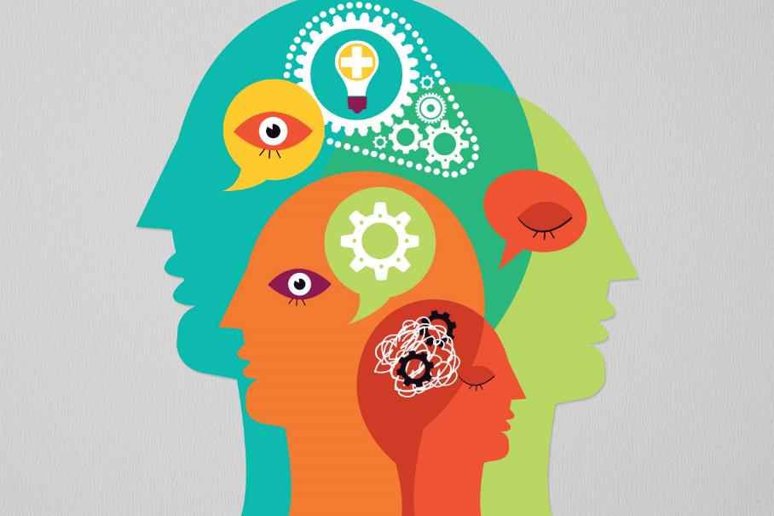
Diagnostic Overshadowing and Bias
Diagnostic overshadowing stems from cognitive/unconscious bias and is one factor that can contribute to health inequities for people with conditions or characteristics that may result in diagnostic overshadowing.

Slide 21
Consequences of Diagnostic Overshadowing
Some potential consequences of diagnostic overshadowing can include, but are not limited to:
Worsening physical conditions
Decreased willingness on the part of the patient to seek care for ailments they fear may not be taken seriously
Significant impact on quality of life for patients
Delays in diagnosis or treatment of new or other co-morbid conditions
Unnecessary or unsafe care or treatment
Inequities in care and/or health outcomes
Death

Slide 22
Case Example – Mental Health
Patient with multiple mental illness diagnoses, including borderline personality disorder and a history of eating disorder. Patient also has history of migraines and Raynaud’s Syndrome (restriction of blood flow to fingers and toes).
Situation 1:
Patient began having episodes of crushing chest pain
Emergency Department (ED) ruled out heart attack
Follow up with cardiologist who indicated that the chest pain was due to anxiety after spending “only 5 minutes” with the patient in the exam room

Slide 23
Case Example – Mental Health - 2
This patient sought a second opinion, which resulted in a diagnosis of an uncommon form of decreased blood flow to the heart called Prinzmetal’s Angina.
Patient started treatment with medications which quickly resulted in a decrease of both the frequency and severity of chest pain attacks.

Slide 24
Case Example – Mental Health - 3
Situation 2
Patient began to frequently feel nauseated with stomach pain.
Referred to a gastroenterologist
Consultation resulted in a diagnosis of Functional Abdominal Pain Syndrome (FAPS)
Provider told patient she would have to “learn to live with it”
Patient researched FAPS only to find out that it was classified as a somatization disorder – when a person has a significant focus on physical symptoms to levels that result in major distress and/or problems functioning

Slide 25
Case Example – Mental Health - 4
Patient again sought a second opinion.
New provider began a series of testing and after a breath test diagnosed small intestinal bacterial overgrowth.
Patient reports that it took over a year to regain the weight that was lost from these symptoms, and “even longer to confront the emotional toll of having my eating disorder triggered.”

Slide 26
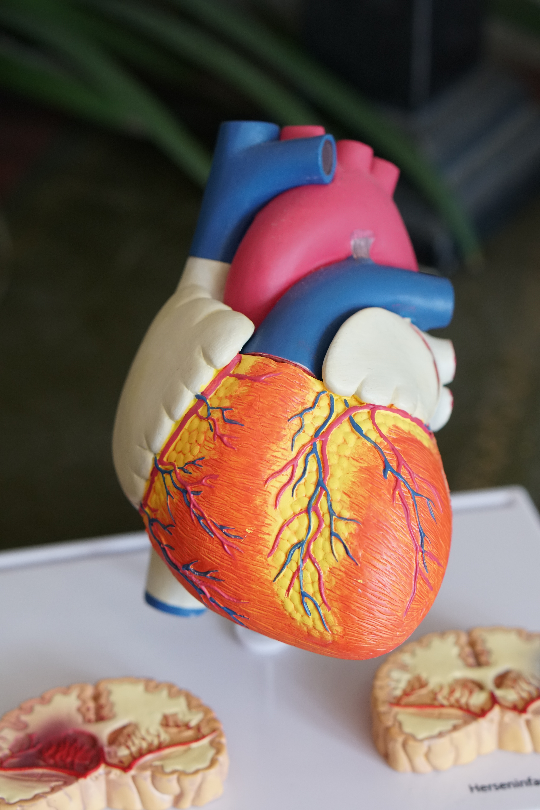
Case Example – Mental Health – What Went Wrong
What types of biases may have contributed to these providers misattributing symptoms to mental health when there were other root causes?
Prominence of stigma and negative stereotypes around metal health may have overshadowed other potentially relevant medical history.
Notes:
Attribution bias – attributing new symptoms to what we already know about the patient – mental health conditions. Prominence of stigma around mental health may have overshadowed

Slide 27
Case Example – Intellectual Disability
Patient is a 15 year old female with moderate intellectual disability, presenting with complaints of irritability and anger outbursts that have been ongoing and worsening for the past year. Patient has limited expressive language skills and uses predominantly nonverbal communication.
Throughout the past year, patient has become increasingly solitary, expressed irritability towards family members and was often late for school.
Parents observed strange behavioral changes such as the patient preferring to be alone in the bathroom for long amounts of time.
Attempts to increase punctuality or redirect from the bathroom to other tasks resulted in tantrums, anger outbursts and self-injurious behaviors.

Slide 28
Case Example – Intellectual Disability - 2
Medication prescribed to decrease irritability, however problem behaviors persisted resulting in significant caregiver distress.
Multidisciplinary team of psychiatrists, psychologist and mental health nurses assessed patient using structured assessment for diagnosis.
In this process, parents reported that time spent in bathroom was for personal hygiene because of repetitive and compulsive washing of hands. Patient was calm when able to complete these actions, but restriction of behaviors resulted in irritability previously reported.

Slide 29
Case Example – Intellectual Disability - 3
Treatment began for Obsessive Compulsive Disorder, starting with medication due to limits of cognitive therapy with communication difficulties. Nursing team provided psychosocial interventions for parents/caregivers, as well as coping skills training for the patient.
This resulted in significant improvement in both symptomatic and functional outcomes.

Slide 30
Case Example – Intellectual Disability – What Went Wrong
Parents erroneously believed that behaviors were a manifestation of the patient’s disability.
Did not initially mention details about the compulsive nature of the behaviors.
Initial evaluations focused on irritability without assessing or asking questions related to mental health conditions to assess potential underlying causes.

Slide 31
Case Example – Intellectual Disability – What Went Wrong - 2
Intellectual disability and communication difficulties pose challenges to typical mental health assessment processes
In this case – the specialized care team has experience in other forms of assessment as well as manifestations of mental health in this population, so were better equipped to make a thorough and accurate diagnosis
The structured assessment process focused on the onset, evolution, context of occurrence, and aggravating and relieving factors of the problem behaviors, eventually allowing the treating team to tease out compulsive symptoms that were not previously reported by the parents, resulting in a diagnosis

Slide 32
Case Examples – Physical Disability
Findings from a qualitative study that interviewed individuals with mobility disabilities regarding the diagnosis and treatment of their cancer found the following:
Signs and symptoms were not always taken seriously by physicians, often due to erroneous assumptions that the cause was emotional responses to their chronic health conditions rather than valid medical concerns. Patients reported being told that their pain was due to depression.
One patient reported that after a colonoscopy the provider told her “There’s nothing wrong. You’re complaining for nothing. This is your fifth colonoscopy. There’s nothing wrong with you.” Three days later she received the phone call informing her of her colon cancer.

Slide 33
Case Examples – Physical Disability -2
10 of 20 patients interviewed reported that their cancer diagnoses were delayed due to assumptions that the new signs/symptoms were disability related (either on the part of the patient or their providers).
Patient with spinal cord injury was losing weight for two years. Was diagnosed with gastroparesis, told that because if their SCI they digested food slower, which was the issue. Patient visited the ER 5 times over two years while the gastroparesis diagnoses held despite no testing for this diagnosis. Eventually the patient’s weight loss became life-threatening and an x-ray was done to place a feeding tube, which found a mass next to the patient’s right lung that was Stage II Hodgkin’s lymphoma.

Slide 34
Case Examples – Physical Disability – What Went Wrong
In some cases, symptoms were attributed to depression and other mental health conditions due to biases and assumptions about the quality of life for people with physical disabilities
In others, patients delayed their own care after attributing new symptoms to their physical disabilities
Notes:
PT with SCI – confirmation bias – confirming information already available vs looking for new causes
Horns bias – attributing physical disability as a negative aspect that would result in patients having depression and other mental health conditions

Slide 35
Patient Biases and Potential Care Impacts
Patients will have their own biases that may impact their care and our ability to provide care.
Think about a time where you had a less than perfect experience with a doctor, store, restaurant, etc. Does that impact you when you think about returning?
For some patient populations, if they have had difficulty feeling as though they were being heard and taken seriously, may be less likely to seek out care for new symptoms as a result of past negative experiences.
Notes:
Patients may have horns bias against medical providers or certain offices or practices, which can delay seeking of care for new symptoms.

Slide 36
Patient Biases and Potential Care Impacts Continued
Patients may also wrongly attribute new symptoms to pre-existing conditions and either not seek care, or underemphasize the impact of these new symptoms at routine appointments.
Patients may have biases or experiences that impact their engagement with providers based on factors unrelated to health care.

Slide 37
Strategies to Prevent Diagnostic Overshadowing

Slide 38
Acknowledging that Diagnostic Overshadowing Exists
The first step in preventing the occurrence and negative outcomes of diagnostic overshadowing is to acknowledge that it exists, and that it’s occurrence is both widespread and serious.
Create an awareness of diagnostic overshadowing during clinical peer and quality assurance reviews – evaluate if diagnostic overshadowing or any other form of bias may have contributed to an adverse outcome when reviewing adverse events.

Slide 39
Resources for Building Awareness of Our Own Biases
Self-reflect and increase awareness of our own biases so that we can take intentional steps to overcome these biases
Rocky Mountain ADA Center Training – Includes an online, self-paced training on Minimizing Implicit Bias
Project Implicit through Harvard University
LinkedIn Learning courses and videos

Slide 40
Confronting Bias
Building awareness of the impact of bias and diagnostic overshadowing may make us more likely to recognize when it may be happening.
Calling out and confronting bias in the moment is hard!
Practicing strategies and phrases to confront biases can help prepare us to act in the moment.
Resource: Calling Out vs Calling In from John Hopkins

Slide 41
Confronting Bias – Be an Upstander
We may hesitate to confront bias because of the bystander effect:
We may be less likely to act in a situation when others are around because we assume that someone else will respond.
A more recent challenge to the bystander effect is being an “Upstander” – someone who takes actions in situations where the bystander effect is likely to occur, such as when bias, microaggressions, discrimination or diagnostic overshadowing may occur.
Notes:
You may have heard of some of the well known studies of the bystander effect, where people were less likely to call for help when seeing a woman get mugged on the street when other people were around. However this effect occurs with a variety of scenarios and not just those are significant. In one example, people were told they were participating in a product demonstration and review for a camping tent. The person setting up the tent struggled with the process, and the larger the group of participants the longer it took for people to step in and help. When it was just the participant and staff person present, people offered to help significantly faster.

Slide 42
Be an Upstander – The Three Ds of Intervention
Direct: Directly challenge something in the moment, or directly check in with the person who is the subject of the bias to see if they are ok
“I don’t think we should assume that these symptoms are related to the patient’s disability without exploring other options first”
Delegate: Tell another person who can help intervene, such as a supervisor or person with authority
Distract: Interrupt the situation or redirect individuals who may be at risk
Notes:
In the case of diagnostic overshadowing, direct intervention may be most appropriate when this is suspected during a patient encounter. Delegation can be a helpful strategy if a suspicion arises after the fact, or for a patient to bring awareness of their concerns to the attention of clinic leadership.
Sometimes combinations of intervention can be helpful as well. For cases of discrimination or inappropriate language or behaviors, it can be helpful to distract in the moment to diffuse the situation, then following up with direct and/or delegation interventions.

Slide 43
Assessment/Diagnosis Strategies
Use listening and interviewing techniques designed to gain better patient engagement and shared decision making
Pay attention to non-verbal communication, and the impact of the environment/physical setting on communication
Don’t make assumptions about a person’s quality of life, or assume that QOL is lessened by pre-existing conditions
Assess all aspects of health and wellbeing as potential root causes for changes in behavior
Ask open ended questions to get to know patients and their unique lived experiences

Slide 44
Assessment/Diagnosis Strategies - 2
When possible, seek out help from the patient’s support networks to better understand the patient, how to communicate effectively with them, and to better understand baseline and changes in behaviors
When possible, utilize interdisciplinary teams to meet complex patient needs (ex: mental/behavioral health specialists)
When appropriate, document disability related needs and accommodations in the patient’s chart to facilitate success in future appointments or with other providers that utilize a shared electronic record

Slide 45
Assessment Strategies Video
Caring for The Whole Person with Physical Disabilities
Notes:
This video shows a provider meeting with a new patient for the first time and asking open ended questions both to get to know the patient but to build trust to facilitate a positive relationship with trust and confidence. (Doctor is a real doctor, patient is an actor who does not actually have cancer).

Slide 46
Strategies for Patients
If you suspect that a provider’s biases may be impacting the care you are receiving or potentially leading to diagnostic overshadowing – feel empowered to speak up.
“I don’t think we should assume that these symptoms are related to my disability without exploring other potential causes first”
Seek second opinions when needed
Give feedback about your experiences to the clinic or organization – reach out to the manager of the clinic/unit or ask for contact information for Patient Representatives

Slide 47
Questions?

Slide 48
References
Agaronnik, N. D., El-Jawahri, A., & Iezzoni, L. I. (2020). Perspectives of patients with pre-existing mobility disability on the process of diagnosing their cancer. Journal of General Internal Medicine, 36(5), 1250-1257.
Examples of Disability Microaggressions in Everyday Life. Washington State University. https://www.vancouver.wsu.edu/equity-diversity/examples- disability-microaggressions-everyday-life
Grawitch, M. (2020). Biases are neither all good nor all bad. Psychology Today. https://www.psychologytoday.com/us/blog/hovercraft-full- eels/202009/biases-are-neither-all-good-nor-all- bad#:~:text=Biases%20evolved%20to%20allow%20us,regarding%20which %20choice%20to%20make.

Slide 49
References - 2
Hallyburton, A. (20220). Diagnostic overshadowing: An evolutionary concept analysis on the misattribution of physical symptoms to pre-existing psychological illnesses. International Journal of Mental Health Nursing, 31(6), 1360-1372.
Iezzoni, L. I. (2019). Dangers of Diagnostic Overshadowing. New England Journal of Medicine, 380(22). 2092-2093
Iezzoni, L. I., Sowmya, R. R., Ressalam, J., Bolcic-Jankovic, D., Agaronnik, N. D., Donelan, K., Lagu, T., & Campbell, E. G. (2020). Physicians’ perceptions of people with disability and their health care. Health Affairs, 40(20), 297-306.

Slide 50
References - 3
Javaid, A., Nakata, V., & Michael, D. (2019). Diagnostic overshadowing in learning disability: Think beyond the disability. Progress in Neurology and Psychiatry, 23(2), 8-10.
Kallur, A., Yoo, E., Bien-Aime, F., & Ammar, H. (2022). Diagnostic overshadowing and pain insensitivity in a schizophrenic patient with perforated duodenal ulcer. Cueus, 14(2).
Miller, L. (2021). Unconscious bias: Your brain on bias (Pt 1: An Audio Illusion). https://www.linkedin.com/pulse/unconscious-bias-your-brain-pt-1-audio- illusion-landy-miller-m-ed-/

Slide 51
References - 4
Manohar, H., Subramanian, K., Kandasamy, P., Penchilaiya, V., & Arun, A. (2016). Diagnostic masking and overshadowing in intellectual disability: How structured evaluation helps. Journal of Child and Adolescent Psychiatric Nursing, 29, 171-176.
Ransley, K., & Holcombe, A. O. (2017). Three visual illusions that reveal the hidden workings of the brain. The Conversation. https://theconversation.com/three- visual-illusions-that-reveal-the-hidden-workings-of-the-brain-80875
Rosenhaft, A. (2021). My experience with diagnostic overshadowing. National Alliance on Mental Illness. https://www.nami.org/Blogs/NAMI-Blog/October- 2021/My-Experience-with-Diagnostic-Overshadowing

Slide 52
References - 5
Spears, T., & Schmader, W. (2021). Unconscious bias in healthcare. Physician Leadership Journal, 8(2), 22-24.
The Joint Commission. (2022). Sentinel event alert: Diagnostic overshadowing among groups experiencing health disparities. https://www.jointcommission.org/resources/sentinel-event/sentinel-event- alert-newsletters/sentinel-event-alert-65-diagnostic-overshadowing-among- groups-experiencing-health-disparities/#.Y78tD3bMKUk

